Slide 1
Business Communication for The Digital Workplace
EAC594

Slide 2
Positive and Negative Business Messages

Slide 3
Agenda
Chapter 8: Routine Messages
Positive, Negative, & Persuasive Messages
Structure, Formatting and Best Practices
Examples
Slide Design Assignment
Final Team Presentation

Slide 4

Positive Business Messages

Slide 5
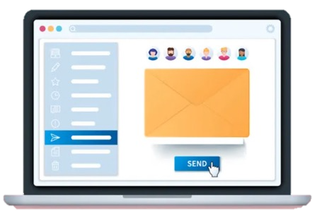
Routine Messages
Requests for information or action
Replies to customers
Explanations to coworkers
Instructions
Claims and complaints
Adjustments
Goodwill messages
https://www.vectorstock.com/

Slide 6

Effective Positive Messages and the Writing Process (1 of 3)
Phase 1:
Analyzing, Anticipating, and Adapting
Why am I writing?
How will the reader react?
What channel should I use?
How can I save my reader’s time?

Slide 7

Effective Positive Messages and the Writing Process (2 of 3)
Phase 2:
Researching, Organizing, and Drafting
Collect information.
Choose the best organizational strategy.
Compose the first draft.
Group similar information together.
Keep your paragraphs short.

Slide 8

Effective Positive Messages and the Writing Process (3 of 3)
Phase 3:
Editing, Proofreading, and Evaluating
Is the message clear?
Is the message correct?
Did you plan for feedback?
Will this message achieve its purpose?

Slide 9

Information Shares
It is the most common routine message
The sender provides information that helps the receiver

Slide 10
Information Shares
Formula:
Opening >> Purpose = what’s the purpose
Body >> Details = provide relevant details
Closing >> Action = what do you want the readers to do

Slide 11
Information Shares
 |  | Hi Karin, I just saw a CFP for a new funding opportunity you can apply for via the Ministry of Agriculture.
 |  | Find it on the Greenbelt Fund’s Local Food Literacy Grant Stream page. If you haven’t already been doing this, you should also check out the Ministry’s general page on Funding Programs and Support to connect with any other grants etc. relevant to the good work you do.
 |  | It looks like the deadline for proposals is at the end of the week, though, so you might want to get on it right away. Good luck! Shradha

Slide 12
Information Shares
Opening | Main PURPOSE of information | Hi Karin, I just saw a CFP for a new funding opportunity you can apply for via the Ministry of Agriculture.
Body | Information context and further DETAILS | Find it on the Greenbelt Fund’s Local Food Literacy Grant Stream page. If you haven’t already been doing this, you should also check out the Ministry’s general page on Funding Programs and Support to connect with any other grants etc. relevant to the good work you do.
Closing | ACTION regarding the information | It looks like the deadline for proposals is at the end of the week, though, so you might want to get on it right away. Good luck! Shradha

Slide 13
Requesting Information & Action
All employees send and receive requests for information and action all day
They typically provide the recipient with direction on what to do

Slide 14
Requesting Information & Action
Formula:
Opening >> Purpose = request for particular action
Body >> Details = context and further details
Closing >> Action = deadlines and submission information

Slide 15
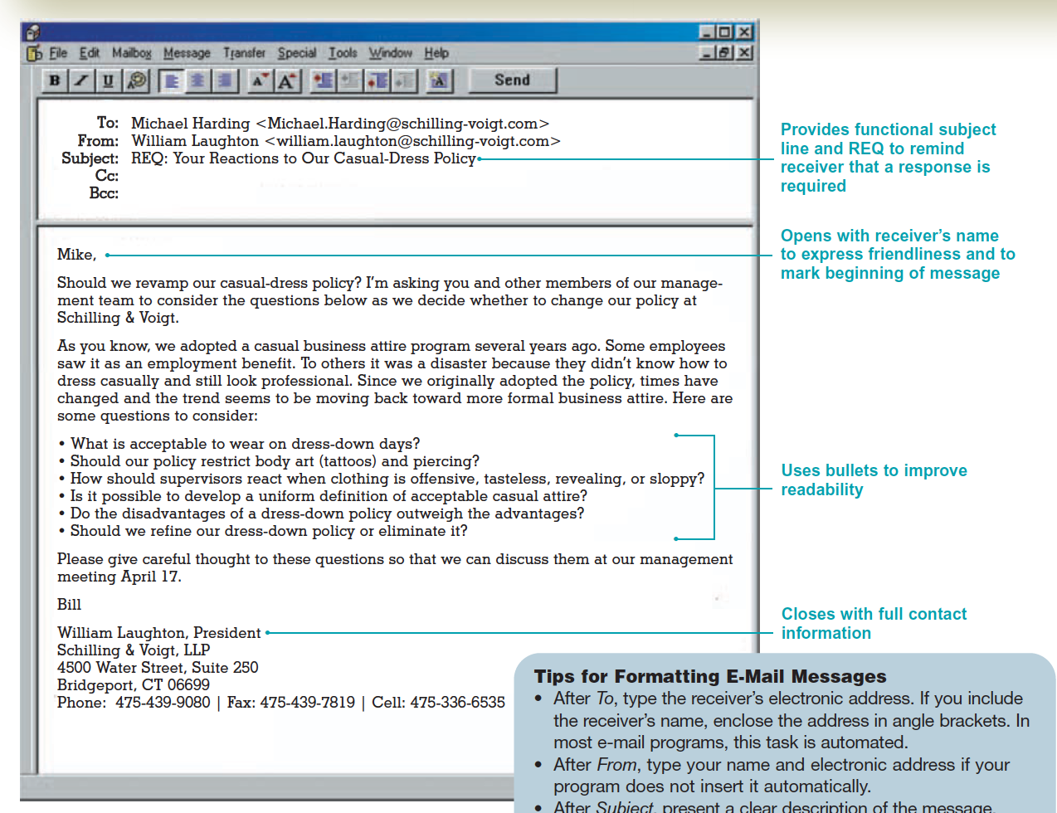
Requesting Information & Action Example

Slide 16
Requesting Information & Action Analyse this email
Dear Sir,
Because we are one of the largest banking systems in the country, we receive hundreds of résumés from job candidates every day. We need help in sorting and ranking candidates by categories, such as job classification, education, work history, skills, and experience.
Recently, I was reading a Workforce magazine article, and the March issue has a story about your new software program called Resume. It sounds fascinating and may be the answer to our problem. We would like more information about this program, which is supposed to read and sort résumés.
In addition to learning if the program can sort candidates into the categories mentioned earlier, I am wondering if the program can read all the different type fonts and formats that candidates use on their résumés. Another important consideration for us is training and troubleshooting. If we need help with the program, would you supply it?
Thank you for your cooperation.
Sincerely,

Slide 17
Information & Action Requests
Critical Thinking Questions:
What is the purpose of the routine request?
What do you think the receiver’s reaction will be to this letter?
Should the email be developed directly or indirectly? How is it currently developed?
What information should be included in the body? How could it be organized for improved readability?
How could the closing be worded to ensure that you get a response (feedback) by a specific date?

Slide 18
Information & Action Requests Revised and Improved Request.
Dear Resume Product Manager:
Please send me information about your Resume software program, which I read about in the March issue of Workforce magazine.
My company receives hundreds of résumés daily, and, frankly, we need help in processing them. Answers to the following questions would help us determine whether Resume could solve our problem.
In terms of fonts and formats, what kinds of résumés can your software program read?
Can the program help us sort and rank candidates by categories such as job classification, education, work history, skills, and experience?
How does your company provide training and trouble-shooting service for your software?
Thanks for answering these questions and for providing any other information about Resume. I would appreciate your response by April 1 so that we can study the program before the rush of job applications in June.
Sincerely,

Slide 19
Replies
Deliver the needed information requested
Confirm the action has been completed
Or provide a reason, or reasons why it can't be done

Slide 20
Complaints and Claims
A complaint explains what went wrong and asks for a correction or apology
A claim explains what went wrong and requests compensation from the offending party

Slide 21
Complaints and Claims
Follow the Direct Approach
Employ the three-part message organization
Opening >> Purpose – main action/request
Body >> Details - events justifying the claim
Close >> Action - deadline/submission details

Slide 22
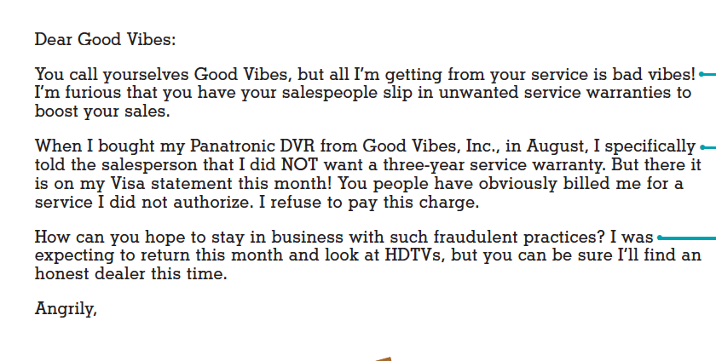
Claim - Analyse this email

Slide 23
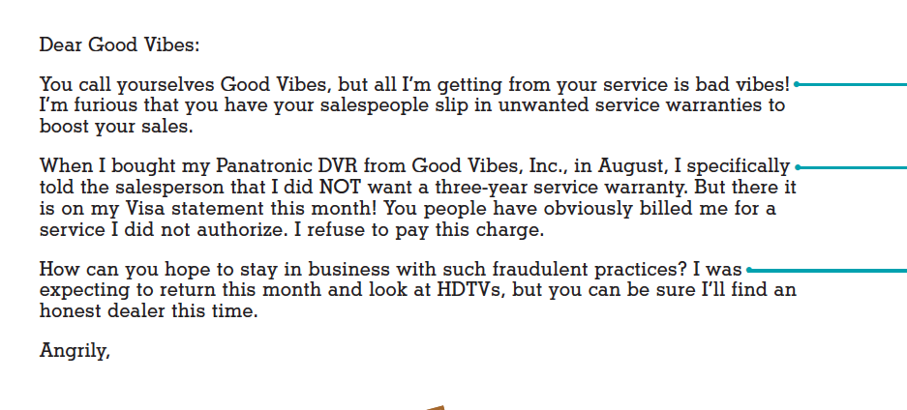
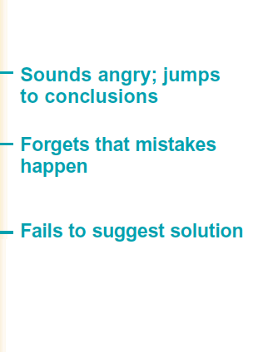
Claim - Analyse this email

Slide 24
Complaints and Claims
Opening
Explain immediately what you want done.
State the remedy briefly when it is obvious (Please credit my Visa account).
Explain your goal when the remedy is not obvious.
Source: https://www.vectorstock.com/royalty-free-vector/employee

Slide 25
Complaints and Claims
Body
Explain the problem and justify your request.
Provide details objectively and concisely.
Be organized and coherent. Don’t ramble. Avoid becoming angry or trying to fix blame.
Source: https://www.vectorstock.com/royalty-free-vector/employee

Slide 26
Complaints and Claims
Closing
End courteously with a tone that promotes goodwill.
Request specific action, including end date, if appropriate.
Source: https://www.vectorstock.com/royalty-free-vector/employee

Slide 27
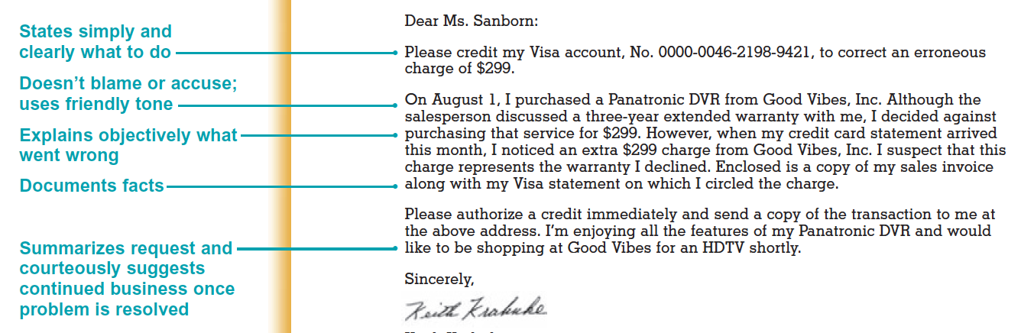
Claim - Revised and Improved

Slide 28
Adjustment Messages
Sent to grant the claimant's request
Follows the direct approach
Tone is professional and courteous
Three goals in adjustment letters:
Rectifying the wrong, if one exists
Regaining the confidence of the customer
Promoting further business

Slide 29

Adjustment Messages
Opening
When approving a customer’s claim, announce the good news (adjustment) immediately.
Avoid sounding grudging or reluctant.

Slide 30
Adjustment Messages
Body
Explain what went wrong (if you know).
Strive to win back the customer’s confidence.
Concentrate on explaining how diligently your organization works to avoid disappointing customers.
Avoid negative language (trouble, regret, fault).

Slide 31
Adjustment Messages
Body
Avoid blaming customers— even if they are at fault.
Avoid blaming individuals or departments in your organization. It sounds unprofessional.

Slide 32
Adjustment Messages
Closing
Show appreciation that the customer wrote.
Consider expressing confidence that the problem has been resolved.
Thank the customer for past business.
Refer to your desire to be of service.

Slide 33
Adjustment Messages - Example
Hello Samantha,
Absolutely, we would be happy to refund you for the $90 warranty mistakenly charged along with your purchase of the Acer laptop. For your inconvenience, we will also offer you a $20 gift card for future purchases at our store.
To receive your refund and gift card, please return to our Belleville location with your receipt and the credit card you purchased the computer with so that we can credit the same card $90. (For consumer protection reasons, we are unable to complete any transactions without the card.)
We are sorry for inconveniencing you and will speak with all sales staff about the importance of carefully checking the accuracy of any bill of sale before sending the order for payment. To ensure that this doesn’t happen again, we will also instruct sales staff to confirm with customers whether an extended warranty appearing on the sales bill is there with consent before completing any transaction.
We appreciate your choosing Future Shock for your personal electronics and look forward to seeing you soon to credit your Visa card and provide you with the best deal in town on the printer you were looking to purchase.
Have a great day!
Melissa

Slide 34
Goodwill Messages
Show a sense of kindness and friendliness.
Build relationship
Includes:
Thank you notes
Congratulatory messages
Expressions of sympathy

Slide 35
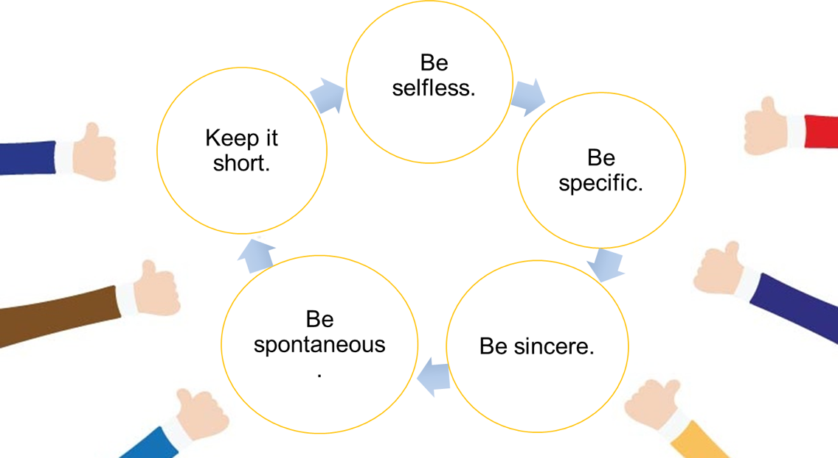
The Five Ss of Goodwill Messages

Slide 36
Goodwill Messages
Follow The 5 S’s
Specific (reference the situation)
Sincere (don't use clichés…It is with a heavy heart)
Selfless (focus on the receiver, not yourself)
Short (sentences and paragraphs should be concise)
Spontaneous (respond in a timely manner)

Slide 37
Goodwill Message - Example
Hi Alana,
I just wanted to thank you for putting in a good word for me with your manager. She told me today that I came highly recommended, and I knew right away who that came from—only the most kind and thoughtful person I’ve ever had the pleasure of working with! I really appreciate all the help you’ve given me over the years, but especially for bringing me this opportunity. It means a lot to me and my family.
If there’s anything I can help you with in return—anything at all—you name it. I owe you one.
Many thanks,
Jeremy
Figure 4. Goodwill Example Message. Adapted from "Communication@Work" by Smith, 2019.

Slide 38
Negative Business Messages

Slide 39

Goals in Conveying Unfavorable News
Explaining clearly and completely
Conveying empathy and sensitivity
Projecting a professional image
Being fair
Maintaining friendly relations
https://www.vectorstock.com/

Slide 40

Applying the 3-x-3 Writing Process (1 of 5)
Phase 1 Analyzing, Anticipating, and Adapting
Analyze the bad news.
Anticipate its effect on the receiver.
Announce the bad news directly if the disappointment will be mild.
Use the indirect technique if the bad news is serious.
https://www.vectorstock.com/

Slide 41
Applying the 3-x-3 Writing Process (2 of 5)
Phase 2 Researching, Organizing, and Drafting
Gather information.
Brainstorm for ideas.
Jot down all reasons you have to explain the bad news.
https://www.vectorstock.com/

Slide 42
Applying the 3-x-3 Writing Process (3 of 5)
Phase 2 Researching, Organizing, and Drafting
Present only the strongest and safest reasons.
Include ample explanation of the negative situation.
Avoid fixing blame.
https://www.vectorstock.com/

Slide 43
Applying the 3-x-3 Writing Process (4 of 5)
Phase 3 Editing, Proofreading, and Evaluating
Read the message carefully to ensure that it says what you intend.
Check the wording to be sure you are concise without being abrupt.
Read the sentences to see if they sound like conversation and flow smoothly.
https://www.vectorstock.com/

Slide 44
Applying the 3-x-3 Writing Process (5 of 5)
Phase 3 Editing, Proofreading, and Evaluating
Make sure the tone is friendly and respectful.
Check format, grammar, and mechanics.
Evaluate the message: Is it too blunt? Too subtle? Is it clear, but professional?
https://www.vectorstock.com/

Slide 45
Avoiding Legal Liability in Conveying Negative News
Abusive language:
Defamation: Language that harms a person’s reputation
Libel: Written defamation
Slander: Spoken defamation
Language becomes legally actionable if it is false, damaging to someone’s good name, and published.
Careful writers ensure that their words communicate only what they intend.
Notes:
Business Communication: Process and Product 4th Brief Canadian Edition
Pg. 205-06

Slide 46
Avoiding Legal Liability in Conveying Negative News
2. Careless language: Statements that are potentially damaging or that could be misinterpreted
Case of a factory worker injured on the job. His attorney summoned the company documents and discovered a seemingly harmless letter sent to a group regarding a plant tour. These words appeared in the letter:
“Although we are honored at your interest in our company, we cannot give your group a tour of the plant operations as it would be too noisy and dangerous.”

Slide 47
Avoiding Legal Liability in Conveying Negative News
2. Careless language: Statements that are potentially damaging or that could be misinterpreted
“Although we are honored at your interest in our company, we cannot give your group a tour of the plant operations as it would be too noisy and dangerous.”

Slide 48
Avoiding Legal Liability in Conveying Negative News
2. Careless language: Statements that are potentially damaging or that could be misinterpreted
“Although we are honored at your interest in our company, we cannot give your group a tour of the plant operations as it would be too noisy and dangerous.”
The court found in favor of the worker, inferring from the letter that working conditions were indeed hazardous. (The factory is too hazardous.)
The letter writer did not intend to convey the impression of dangerous working conditions, but the court accepted that interpretation.

Slide 49

Avoiding Legal Liability in Conveying Negative News
3. The “Good-Guy” syndrome:
Most of us hate to have to reveal bad news— to be the bad guy.
To make ourselves look better,
to make the receiver feel better, and
to maintain good relations,
We are tempted to make statements that are legally dangerous.
https://www.vectorstock.com/
https://www.vectorstock.com/
https://www.vectorstock.com/
https://www.vectorstock.com/
https://www.vectorstock.com/
https://www.vectorstock.com/
https://www.vectorstock.com/

Slide 50
Avoiding Legal Liability in Conveying Negative News
3. The “Good-Guy” syndrome:
Consider the case of a law firm interviewing job candidates.
One of the firm’s partners was asked to inform a candidate that she was not selected. The partner’s letter said,
“Although you were by far the most qualified candidate we interviewed, unfortunately, we have decided we do not have a position for a person of your talents at this time.”

Slide 51
Avoiding Legal Liability in Conveying Negative News
3. The “Good-Guy” syndrome:
“Although you were by far the most qualified candidate we interviewed, unfortunately, we have decided we do not have a position for a person of your talents at this time.”
Rejected interviewee found out that the law firm had hired two male attorneys
She sued, charging gender discrimination.
The court found in favor of the rejected candidate.
It agreed that a reasonable inference could be made from the partner’s letter that she was the “most qualified candidate.”

Slide 52
Avoiding Legal Liability in Conveying Negative News
Practical Solutions:
Express only the views of your organization when acting as agent of the organization
Avoid supplying information that could be misused.
Use plain paper (or personal email) for your personal matters.

Slide 53


Analyzing Negative News Strategies
Direct Strategy
Indirect Strategy
https://www.vectorstock.com/
https://www.vectorstock.com/
https://www.vectorstock.com/
https://www.vectorstock.com/
https://www.vectorstock.com/

Slide 54

Analyzing Negative News Strategies
Direct Strategy
When the bad news is not damaging
When the receiver may overlook the bad news
When the organization or receiver prefers directness
When firmness is necessary
https://www.vectorstock.com/

Slide 55

Analyzing Negative News Strategies
Indirect Strategy
When the bad news is personally upsetting
When the bad news will provoke a hostile reaction
When the bad news threatens the customer relationship
When the bad news is unexpected
https://www.vectorstock.com/

Slide 56
Analyzing Negative News Strategies
Direct pattern works when
Orders can’t be filled (urgency of situation)
An on-the-job accident with injuries or even death
An unsuccessful product test
A company merger that may result in reductions in force or layoffs
Indirect pattern works well for
Rejecting requests for favours, money, information, action
Declining invitations
Announcing rate increases
Denying claims

Slide 57
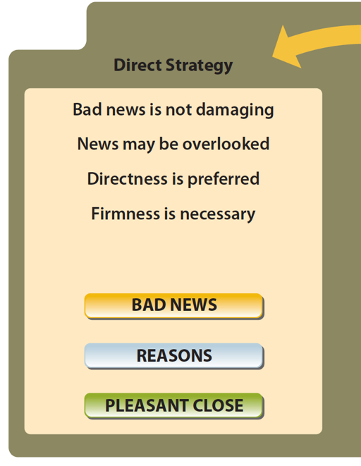
Comparing Strategies for Delivering Negative News

Slide 58
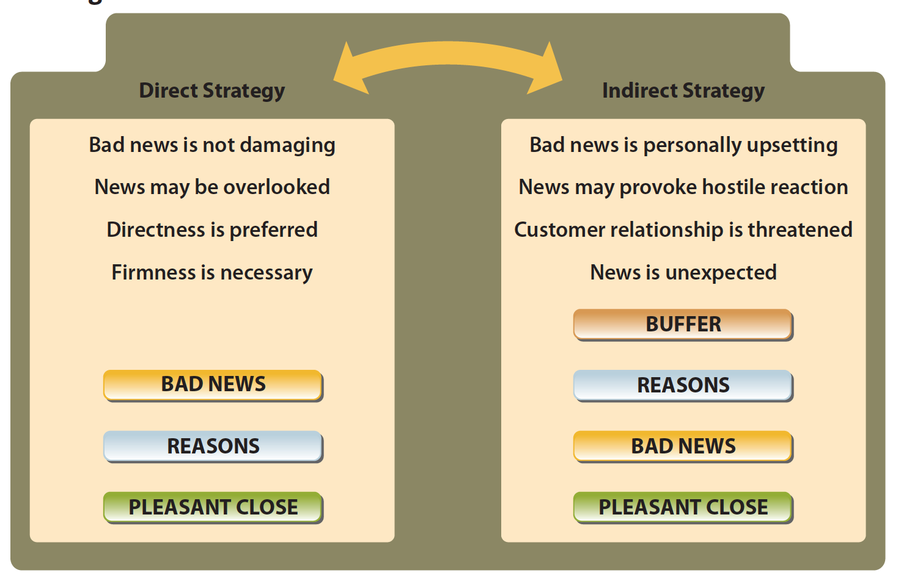
Comparing Strategies for Delivering Negative News

Slide 59
1. Various Buffer Types
Best news (free delivery of prescription while raising insurance premium)
Compliment (declining an invitation)
Appreciation (qualification, skills when refusing employment)
Agreement (rejecting loan application – global economic crisis)
Facts
Understanding

Slide 60
2. Presenting Reasons for the Negative News
Explain the reasons leading up to the bad news.
Cite reader benefit or benefits to others, if plausible.
Explain the rationale behind your company’s policy.
Choose positive words to keep the reader in a receptive mood.
Show fairness and serious intent.

Slide 61
Other Techniques for Cushioning the Bad News
Position the bad news strategically.
Use the passive voice.
Highlight the positive, if plausible.
Imply the refusal.
Suggest a compromise or an alternative

Slide 62
4. Closing Pleasantly
Forward look: Anticipate future relations or business.
Alternative: Give follow-through advice or offer an alternative, if available.
Good wishes: Express sincere feelings, e.g., thank the reader, if applicable.
Freebies: Send a coupon, sample, or gift, if available, to restore confidence.
Resale or sales promotion: Invite the reader to consider your other products or services.

Slide 63
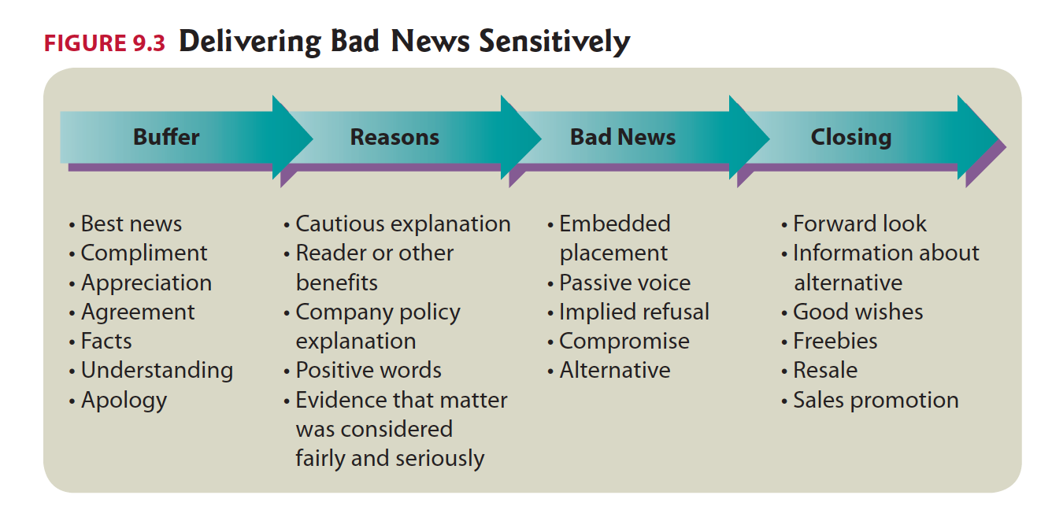

Slide 64
“Before” – Ineffective Customer Request Refusal
Dear Ms. Skyes:
We regret to inform you that we cannot allow you to convert the lease payments you have been making on your Canon X1000 color copier toward its purchase, much as we would love to do so. We understand that you have been making regular payments for the past 16 months.
Our established company policy prohibits such conversion of leasing monies. Perhaps you have noticed that we offer extremely low leasing and purchase prices. Obviously, these low prices would never be possible if we agreed to many proposals such as yours. Because we are striving to stay in business, we cannot agree to your request asking us to convert all 16 months of rental payments toward the purchase of our popular new equipment.
It is our understanding, Ms. Skyes, that you have had the Canon X1000 color copier for 16 months, and you claim that it has been reliable and versatile. We would like to tell you about another Canon model—one that is perhaps closer to your limited budget.
Sincerely,

Slide 65
“Before” – Ineffective Customer Request Refusal
Dear Ms. Skyes:
We regret to inform you that we cannot allow you to convert the lease payments you have been making on your Canon X1000 color copier toward its purchase, much as we would love to do so. We understand that you have been making regular payments for the past 16 months.
Our established company policy prohibits such conversion of leasing monies. Perhaps you have noticed that we offer extremely low leasing and purchase prices. Obviously, these low prices would never be possible if we agreed to many proposals such as yours. Because we are striving to stay in business, we cannot agree to your request asking us to convert all 16 months of rental payments toward the purchase of our popular new equipment.
It is our understanding, Ms. Skyes, that you have had the Canon X1000 color copier for 16 months, and you claim that it has been reliable and versatile. We would like to tell you about another Canon model — one that is perhaps closer to your limited budget.
Sincerely,

Slide 66
“After” – Improved Refusal of Request
Dear Ms. Skyes:
We’re happy to learn that you are enjoying the use of the Canon X1000 color copier you’ve been leasing for the past 16 months.
Like our many other customers, you have discovered that Canon copiers supply remarkable versatility and reliability. One of the reasons we’re able to offer these outstanding copiers at such low leasing rates and equally low purchase prices is that we maintain a slim profit margin. If our program included a provision for applying lease payments toward purchase prices, our overall prices would have to be higher. Although lease payments cannot be credited toward purchase price, we can offer you other Canon models that are within your price range. The Canon 600 delivers the same reliability with nearly as many features as the top-of-the-line Canon X1000.
Please let us demonstrate the Canon 600 to your staff in your office. Our representative, Seth Simmons, will call you during the week of May 5 to arrange an appointment.
Sincerely,
Buffer
Reasons
Bad News
Action - Close

Slide 67
Source
"Communication @ Work" by Jordan Smith is licensed under CC BY 4.0

Slide 68
End

